Slide 1
Regression, classification and regularization
Lecture 1d

Slide 2
Overview
Linear regression
Logistic regression
Basis function expansion
Ridge regression

Slide 3
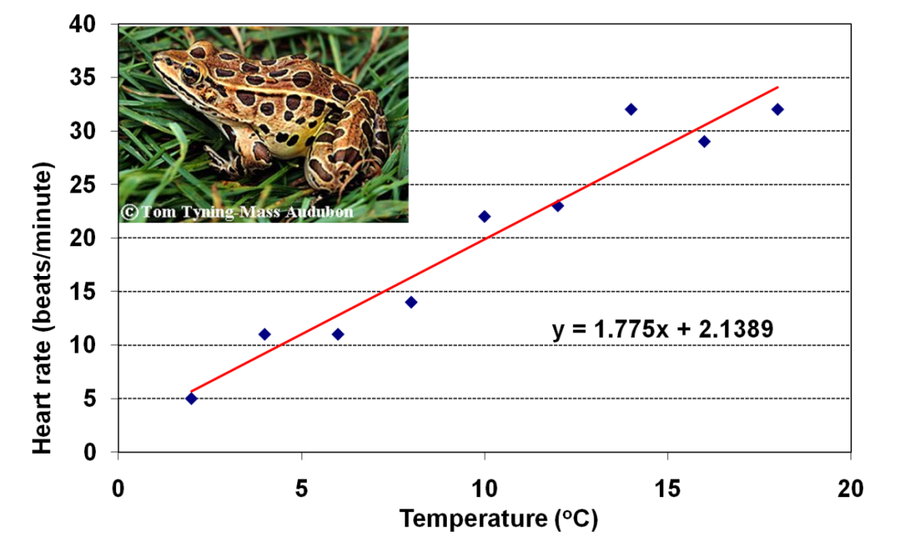
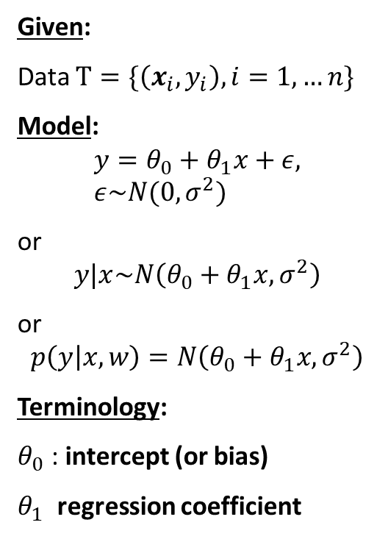
Simple linear regression
Given:
Data $Τ=\{\left(x_{i},y_{i}\right), i=1,…n\}$
Model:
$$y=θ_{0}+θ_{1}x+ε, ε\sim N(0, σ^{2})$$
or
$$y|x\sim N\left(θ_{0}+θ_{1}x, σ^{2}\right)$$
or
$$p\left(y | x,w\right)=N\left(θ_{0}+θ_{1}x, σ^{2}\right)$$
Terminology:
$θ_{0}$: intercept (or bias)
$θ_{1}$ regression coefficient

Slide 4
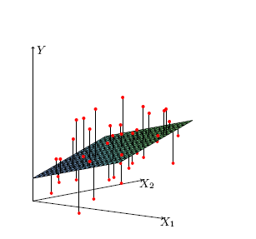
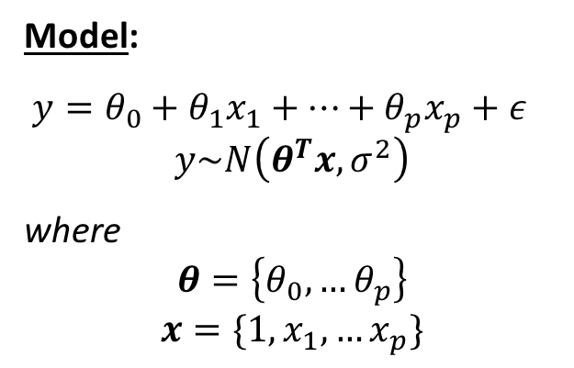
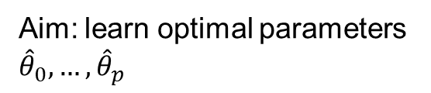
Linear regression
Model:
$y=θ_{0}+θ_{1}x_{1}+…+θ_{p}x_{p}+ε$
$$y\sim N\left(θ^{T}x, σ^{2}\right)$$
where
$$θ=\left\{θ_{0},…θ_{p}\right\}$$
$$x=\{1,x_{1},…x_{p}\}$$
Why is ”1” here?
Aim: learn optimal parameters ${\hat{θ}}_{0},…,{\hat{θ}}_{p}$

Slide 5
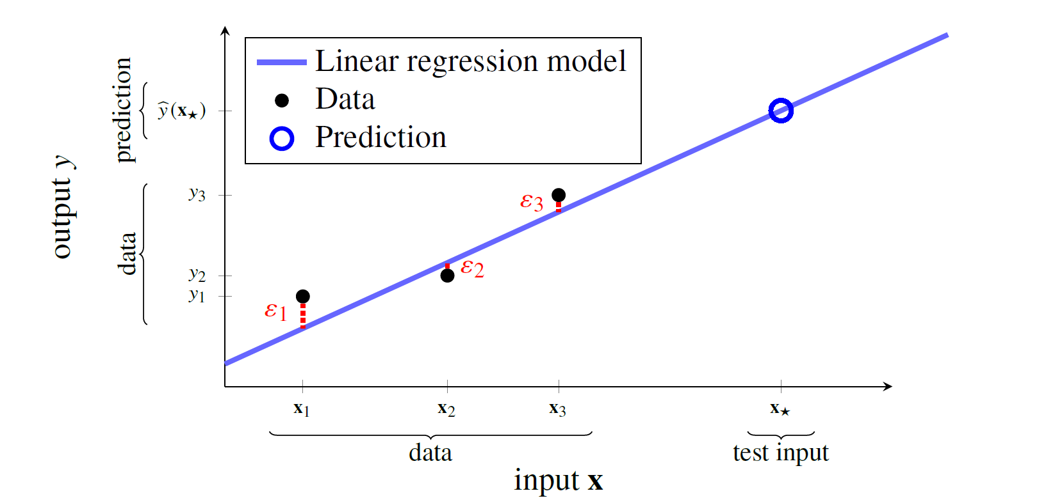

Linear regression
Prediction with linear regression for $x_{∗}$
$$\hat{y}\left(x_{∗}, \hat{θ}\right)={{\hat{θ}}_{0}+\hat{θ}}_{1}x_{∗1}+…{\hat{θ}}_{p}x_{∗p}=\hat{θ}x_{∗}$$
Irreducible error $ε$

Slide 6
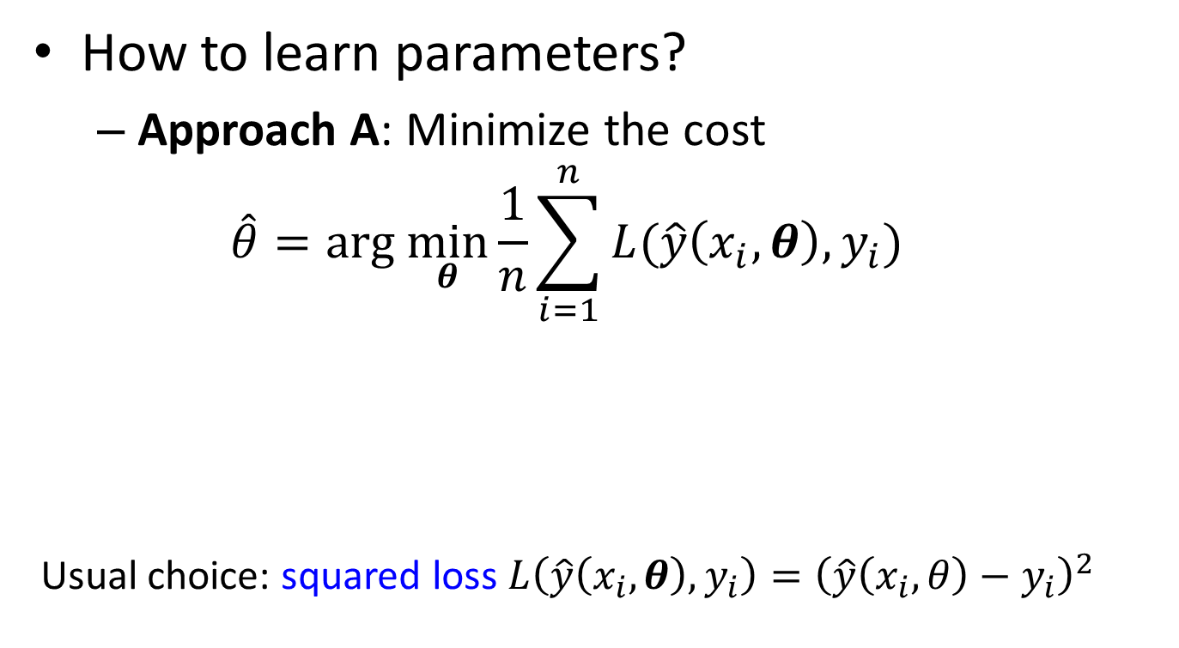
Linear model: learning
How to learn parameters?
Approach A: Minimize the cost
$$\hat{θ}=arg \min_{θ}\frac{1}{n}\sum_{i=1}^{n}{L({\hat{y}\left(x_{i}, θ\right),y}_{i})}$$
Usual choice: squared loss $L\left({\hat{y}\left(x_{i}, θ\right),y}_{i}\right)={\left(\hat{y}\left(x_{i}, θ\right)−y_{i}\right)}^{2}$
Loss function
Cost function

Slide 7

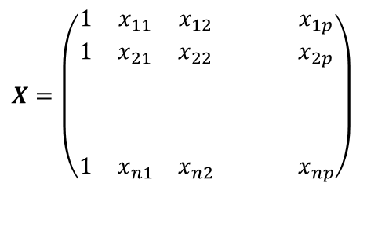


Linear model: learning
Ordinary least squares
Objective: $\min_{θ}\frac{1}{n}\sum_{i=1}^{n}{{\left(y_{i}−x_{i}θ\right)}^{2}}=\min_{θ} {\left(y−Xθ\right)}^{T}(y−Xθ)$
Optimality condition:
where
and
$$X^{T}(y−Xθ)=0$$
$$y=\left(\begin{matrix}y_{1} \\ y_{2} \\ \\ \\ \\ y_{n}\end{matrix}\right)$$
$$X=\left(\begin{matrix}1 & x_{11} & x_{12} & & & x_{1p} \\ 1 & x_{21} & x_{22} & & & x_{2p} \\ & & & & & \\ & & & & & \\ & & & & & \\ 1 & x_{n1} & x_{n2} & & & x_{np}\end{matrix}\right)$$

Slide 8



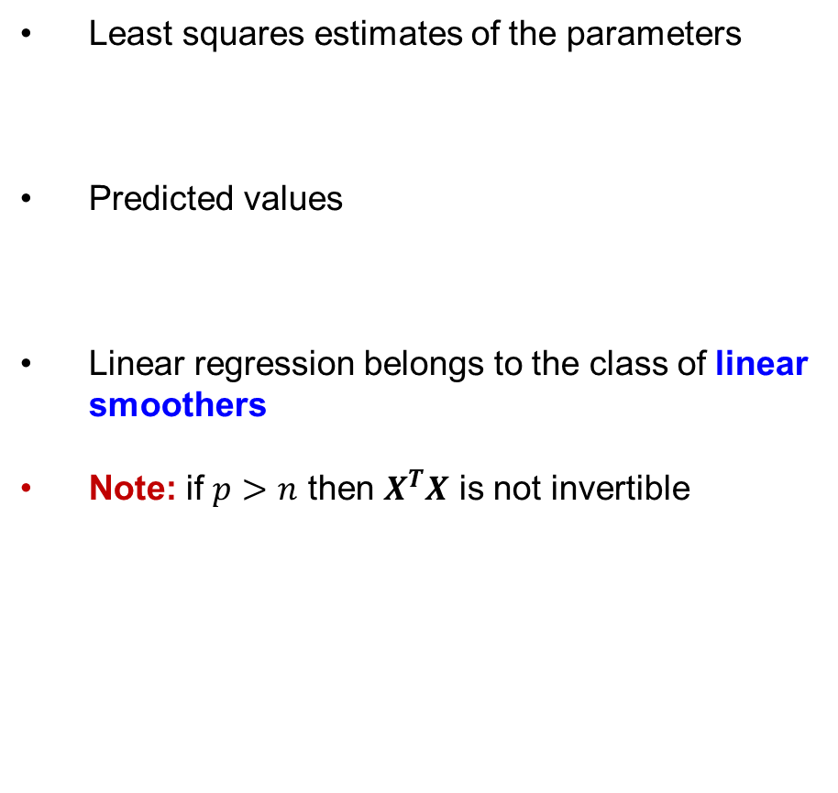
Linear model: learning
Least squares estimates of the parameters
Predicted values
Linear regression belongs to the class of linear smoothers
Note: if $p>n$ then $X^{T}X$ is not invertible
$$\hat{θ}=(X^{T}X)^{−1}X^{T}y$$
$$\hat{y}=X\hat{θ}=X(X^{T}X)^{−1}X^{T}y=Py$$
Hat matrix
Why is it called so?

Slide 9

Linear regression: learning algorithm
Training
Construct $X$ and $y$
Compute $\hat{θ}=(X^{T}X)^{−1}X^{T}y$
Prediction
$\hat{y}\left(x_{∗}\right)={\hat{θ}}^{T}x_{∗}$

Slide 10

Linear model learning
How to learn parameters?
Approach B: Maximize the likelihood
$$\hat{θ}=\underset{θ}{arg max}{p\left(Τ | θ\right)}=\underset{θ}{arg max}{p\left(y | X,θ\right)}$$
Exercise: Approach A and B are equivalent

Slide 11
Linear regression in R
fit=lm(formula, data, subset, weights,…)
data is the data frame containing the predictors and response values
formula is expression for the model
subset which observations to use (training data)?
weights should weights be used?
fit is object of class lm containing various regression results.
Useful functions (many are generic, used in many other models)
Get details about the particular function by ”.”, for ex. predict.lm
summary(fit)
predict(fit, newdata, se.fit, interval)
coefficients(fit) # model coefficients confint(fit, level=0.95) # CIs for model parameters fitted(fit) # predicted values residuals(fit) # residuals

Slide 12
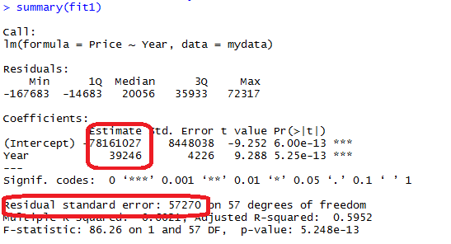
An example of ordinary least squares regression
mydata=read.csv2("Bilexempel.csv")
fit1=lm(Price~Year, data=mydata)
summary(fit1)
fit2=lm(Price~Year+Mileage+Equipment, data=mydata)
summary(fit2)
Response variable:
Requested price of used Porsche cars (1000 SEK)
Inputs:
X₁ = Manufacturing year
X₂ = Milage (km)
X₄ = Equipment (0 or 1)

Slide 13
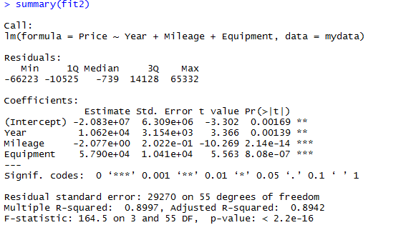
An example of ordinary least squares regression

Slide 14
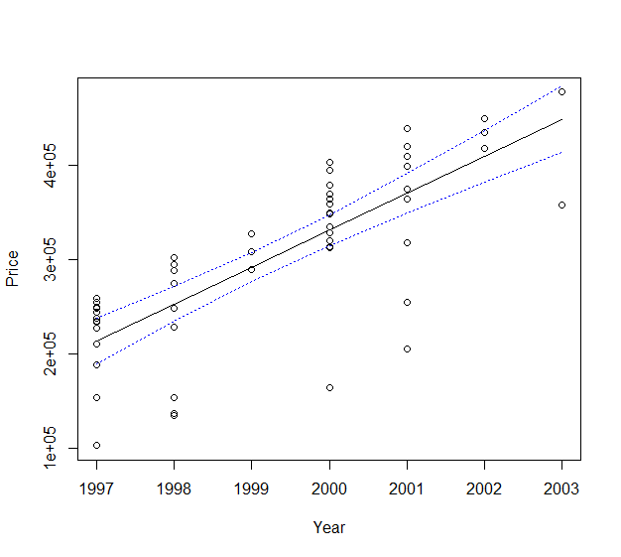
An example of ordinary least squares regression
Prediction
fitted <- predict(fit1, interval = "confidence")
# plot the data and the fitted line
attach(mydata)
plot(Year, Price)
lines(Year, fitted[, "fit"])
# plot the confidence bands
lines(Year, fitted[, "lwr"], lty = "dotted", col="blue")
lines(Year, fitted[, "upr"], lty = "dotted", col="blue")
detach(mydata)

Slide 15
Data scaling
In linear regression not necessary but can improve interpretation when comparing coefficient values
Same transformation on train, valid and test data
Never scale these separately
Normally done on training data as required by many ML methods
In R: library caret
preProcess() to learn transformation
predict() to apply transformation

Slide 16
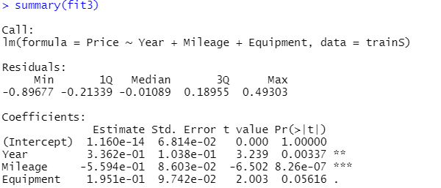
Data scaling
set.seed(12345)
n=nrow(data)
id=sample(1:n, floor(n*0.5))
train=data[id,]
test=data[-id,]
library(caret)
scaler=preProcess(train)
trainS=predict(scaler,train)
testS=predict(scaler,test)
fit3=lm(Price~Year+Mileage+Equipment, data=trainS)
summary(fit3)

Slide 17
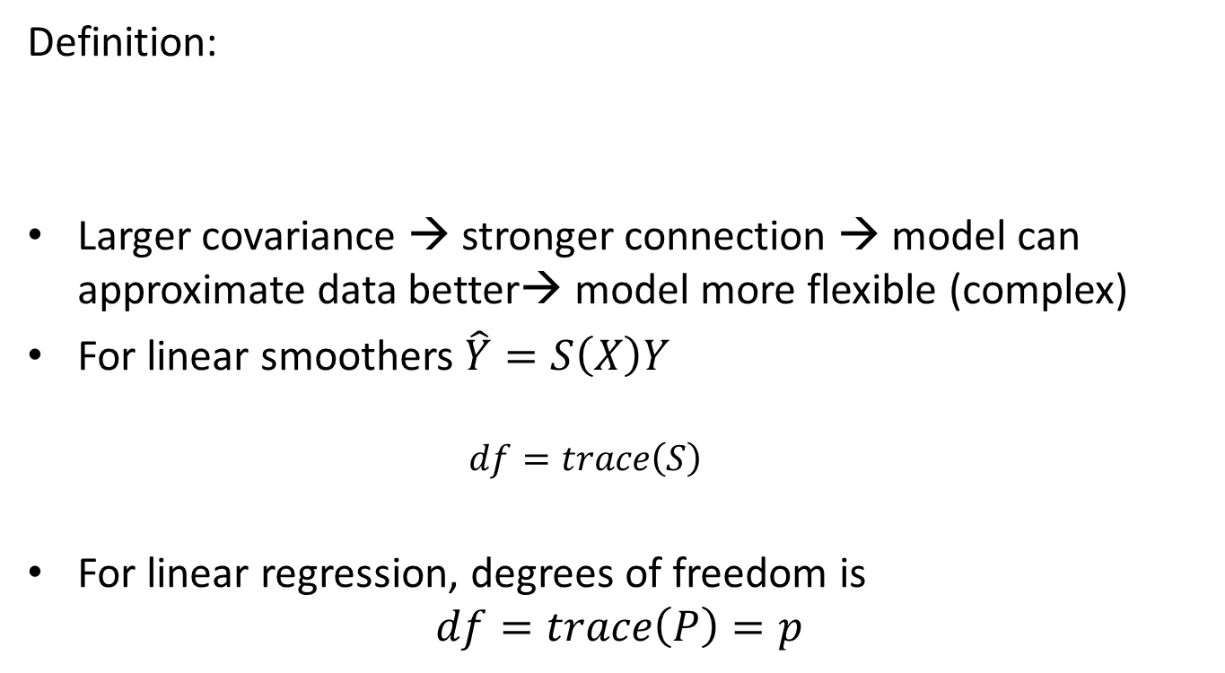
Degrees of freedom
Definition:
Larger covariance → stronger connection → model can approximate data better→ model more flexible (complex)
For linear smoothers $\hat{Y}=S\left(X\right)Y$
$$df=trace\left(S\right)$$
For linear regression, degrees of freedom is
$$df=trace\left(P\right)=p$$

Slide 18
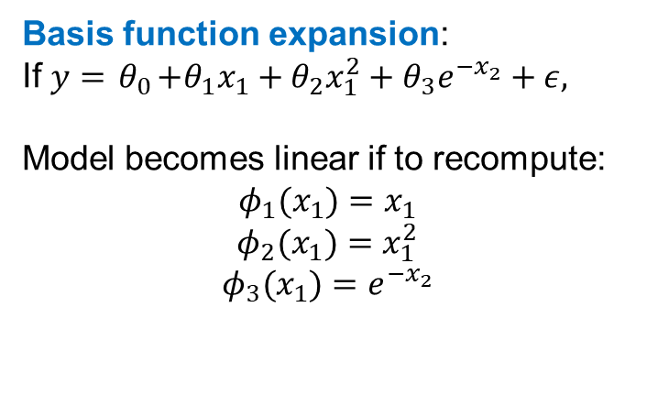
Different types of features
Interval variables
Numerically coded ordinal variables
(small=1, medium=2, large=3)
Dummy coded qualitative variables
Example of dummy coding:
Basis function expansion:
If $y={ θ}_{0}+θ_{1}x_{1}+θ_{2}x_{1}^{2}+θ_{3}e^{−x_{2}}+ε,$
Model becomes linear if to recompute:
$$φ_{1}(x_{1})=x_{1}$$
$$φ_{2}(x_{1})=x_{1}^{2}$$
$$φ_{3}(x_{1})=e^{−x_{2}}$$

Slide 19
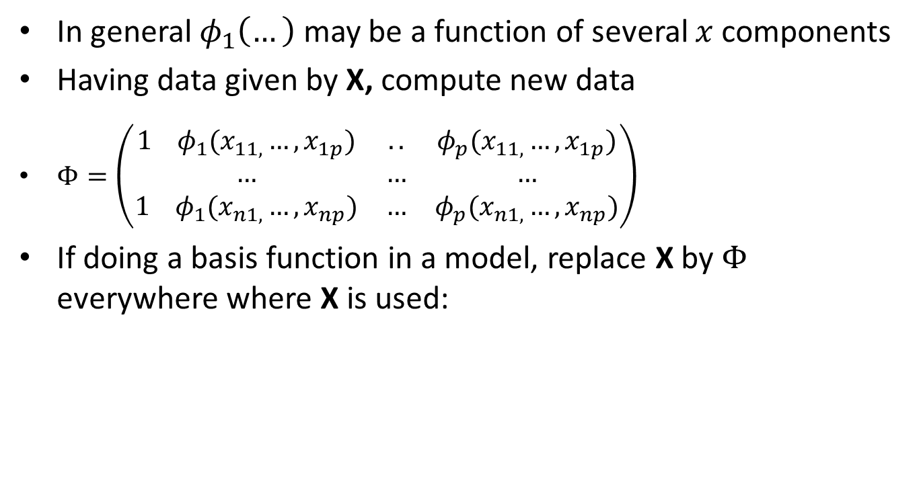
Basis function expansion
In general $φ_{1}\left(…\right)$ may be a function of several $x$ components
Having data given by X, compute new data
$Φ=\left(\begin{matrix}1 { φ}_{1}(x_{11,}…, x_{1p}) & .. & φ_{p}(x_{11,}…, x_{1p}) \\ … & … & … \\ 1 φ_{1}(x_{n1,}…, x_{np}) & … & φ_{p}(x_{n1,}…, x_{np})\end{matrix}\right)$
If doing a basis function in a model, replace X by $Φ$ everywhere where X is used:

Slide 20

Polynomial regression
Do by basis function trick:
$φ_{1}(x_{1})=x_{1}$,$…,φ_{2}(x_{1})=x_{1}^{M}$
High degree of polynomial leads to overfitting.

Slide 21
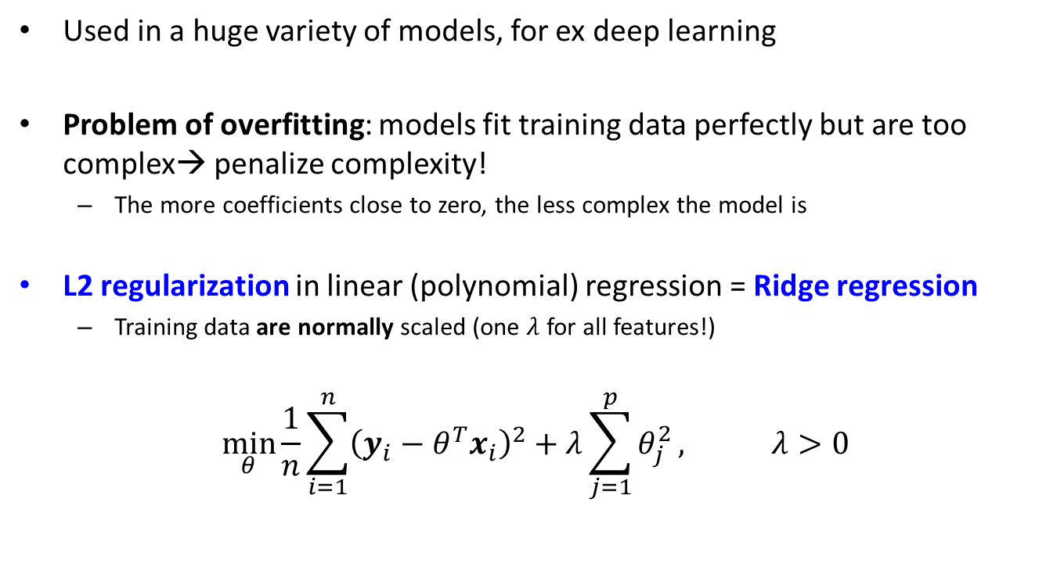
Regularization
Used in a huge variety of models, for ex deep learning
Problem of overfitting: models fit training data perfectly but are too complex→ penalize complexity!
The more coefficients close to zero, the less complex the model is
L2 regularization in linear (polynomial) regression = Ridge regression
Training data are normally scaled (one $λ$ for all features!)
$$\min_{θ}{\frac{1}{n}\sum_{i=1}^{n}{{\left(y_{i}−θ^{T}x_{i}\right)}^{2}+λ\sum_{j=1}^{p}{θ_{j}^{2}}}}, λ>0$$

Slide 22


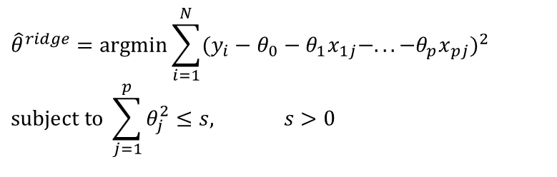
Regularization
Equivalent form
Solution ${\hat{θ}}^{ridge}={\left(X^{T}X+λI\right)}^{−1}X^{T}y$
$${\hat{θ}}^{ridge}=\text{argmin}\sum_{i=1}^{N}{(y_{i}−θ_{0}−θ_{1}x_{1j}−...−θ_{p}x_{pj})^{2}} \\ subject to \sum_{j=1}^{p}{θ_{j}^{2}≤s, s>0}$$
Hat matrix
$$\hat{y}=X\hat{θ}=X(X^{T}X+λI)^{−1}X^{T}y=Py$$
How do we compute degrees of freedom here?
Note: if $p>n$ then $X^{T}X$ is invertible for large enough $λ$

Slide 23

Classification
Given data $D=\left(\left(x_{i},y_{i}\right), i=1…n\right)$
$y_{i}=y(X_{i})=C_{j}∈C$
Class set $C=\{C_{1},…{,C}_{M}\}$
Classification problem:
Decide $\hat{y}\left(x\right)$that maps any $x$ into some class $C_{j}∈C$
Decision boundary

Slide 24
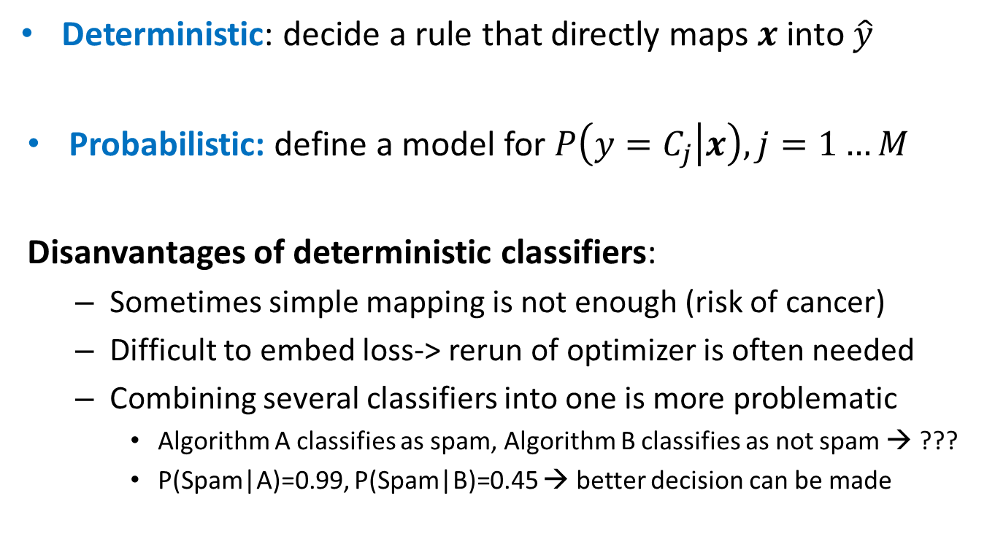
Classifiers
Deterministic: decide a rule that directly maps $x$into $\hat{y}$
Probabilistic: define a model for $P\left(y=C_{j} | x\right), j=1…M$
Disanvantages of deterministic classifiers:
Sometimes simple mapping is not enough (risk of cancer)
Difficult to embed loss-> rerun of optimizer is often needed
Combining several classifiers into one is more problematic
Algorithm A classifies as spam, Algorithm B classifies as not spam → ???
P(Spam|A)=0.99, P(Spam|B)=0.45 → better decision can be made

Slide 25
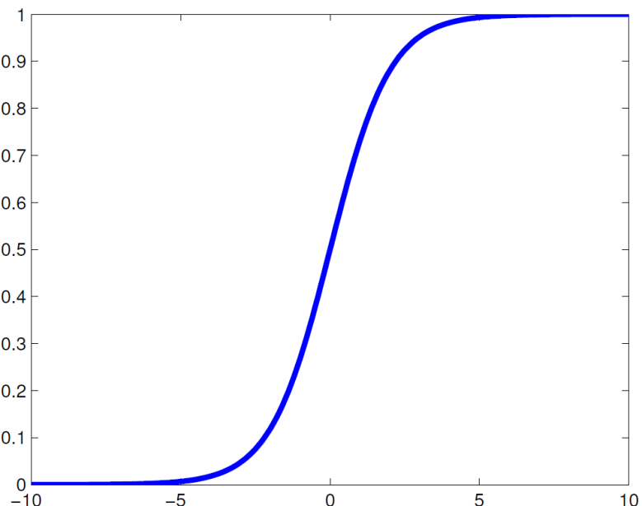
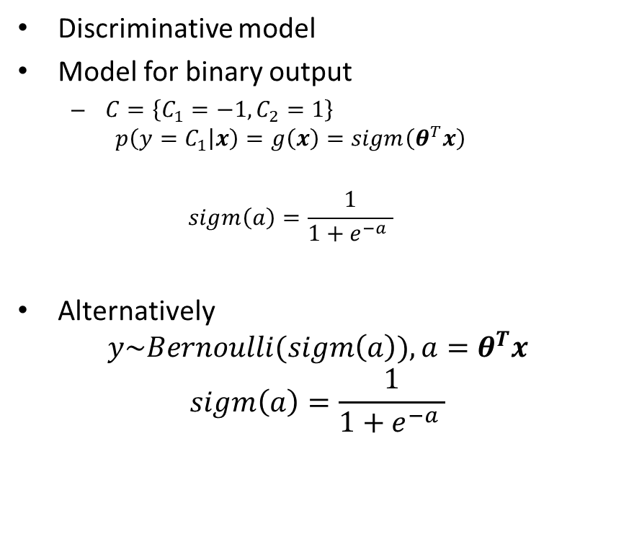

Logistic regression
Discriminative model
Model for binary output
$C=\left\{C_{1}=−1,C_{2}=1\right\}$
$$p\left(y=C_{1} | x\right)=g\left(x\right)=sigm\left(θ^{T}x\right)$$
$$sigm\left(a\right)=\frac{1}{1+e^{−a} }$$
Alternatively
$$y\sim Bernoulli(sigm\left(a\right)), a=θ^{T}x$$
$$sigm\left(a\right)=\frac{1}{1+e^{−a} }$$
What is $p({y=C}_{2}|x)$?

Slide 26

Logistic regression
Logistic model- yet another form
$$ln\frac{p(y=1|x)}{P(y=0|x)}=ln\frac{p(y=1|x)}{1−P(y=1|x)}=logit(p\left(y=1 | x\right))=θ^{T}x$$
Here $logit\left(t\right)=\ln\left(\frac{t}{1−t}\right)$
Note $p(y|x)$ is connected to $θ^{T}x$ via logit link
The log of the odds is linear in x
Example: Probability to buy more than once as function of First Amount Spend

Slide 27
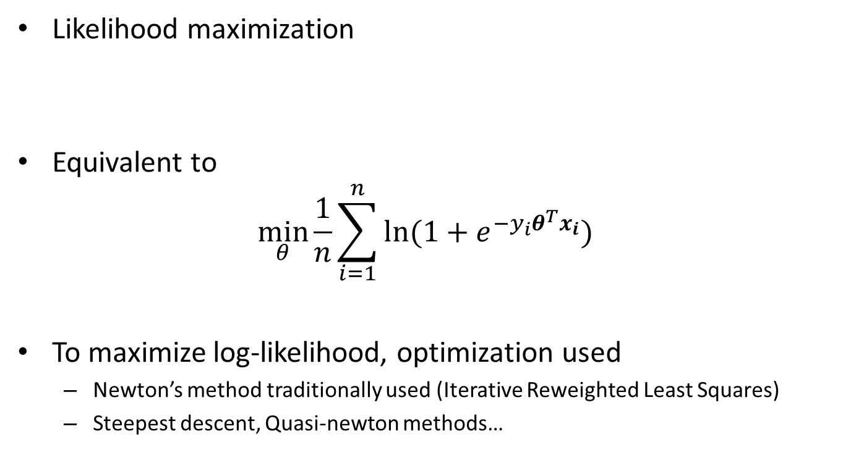
Logistic regression: learning
Likelihood maximization
Equivalent to
$$\min_{θ}{\frac{1}{n}\sum_{i=1}^{n}{ln⁡(1+e^{−y_{i}θ^{T}x_{i}})}}$$
To maximize log-likelihood, optimization used
Newton’s method traditionally used (Iterative Reweighted Least Squares)
Steepest descent, Quasi-newton methods…

Slide 28
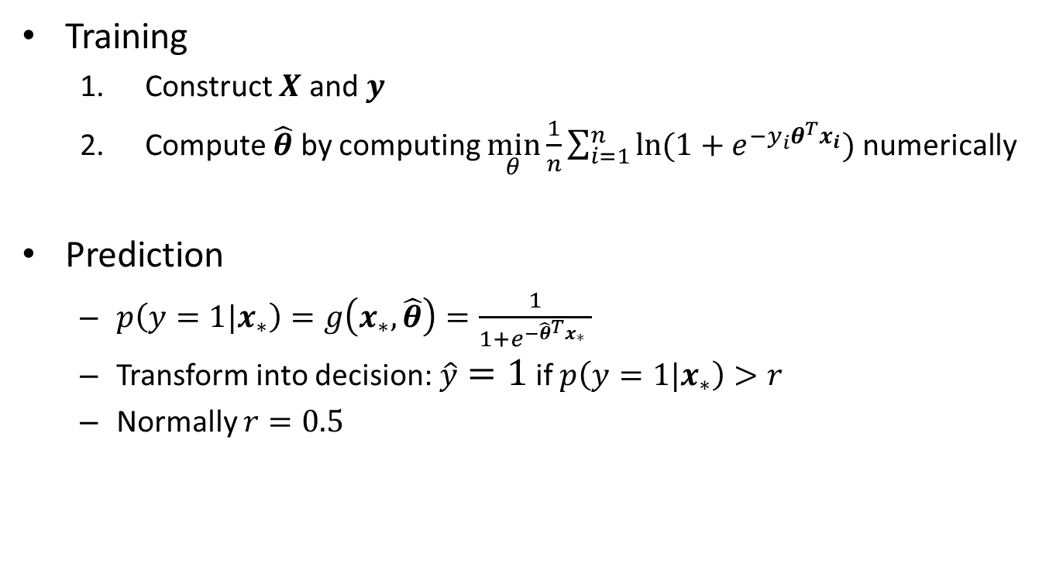
Logistic regression: learning algorithm
Training
Construct $X$ and $y$
Compute $\hat{θ}$ by computing $\min_{θ}{\frac{1}{n}\sum_{i=1}^{n}{ln⁡(1+e^{−y_{i}θ^{T}x_{i}})}}$ numerically
Prediction
$p\left(y=1|x_{∗}\right)=g\left(x_{∗},\hat{θ}\right)=\frac{1}{1+e^{−{\hat{θ}}^{T}x_{∗}} }$
Transform into decision: $\hat{y}=1$ if $p\left(y=1|x_{∗}\right)>r$
Normally $r=0.5$

Slide 29
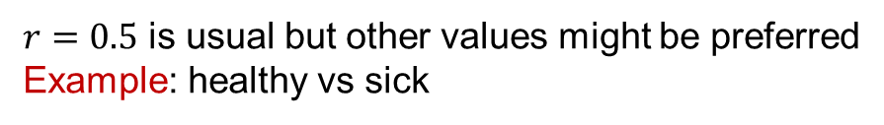
Logistic regression: learning algorithm
$r=0.5$ is usual but other values might be preferred
Example: healthy vs sick

Slide 30

Logistic regression
When $y$ is categorical, set one parameter vector $θ_{i}$ per class $C_{i}$
$$p\left(Y=C_{i} | x\right)=g_{i}\left(x\right)=\frac{e^{θ_{i}^{T}x}}{\sum_{j=1}^{M}{e^{θ_{j}^{T}x}}}$$
$$softmax\left(z\right)=\left(\frac{e^{z_{1}}}{∑e^{z_{i}} },…\frac{e^{z_{M}}}{∑e^{z_{i}}}\right)$$
Alternatively
$$Y\sim Multinomial\left(g_{1}\left(x\right), …g_{M}\left(x\right)\right)$$
Decision boundaries in logistic regression are linear!

Slide 31

Logistic regression: learning
Maximum likelihood
$$\min_{θ}{\frac{1}{n}\sum_{I=1}^{n}{−θ_{{k:y_{i}=c}_{k}}^{T}}x_{i}+ln⁡\sum_{j=1}^{M}{e^{θ_{j}^{T}x_{i}}}}$$

Slide 32
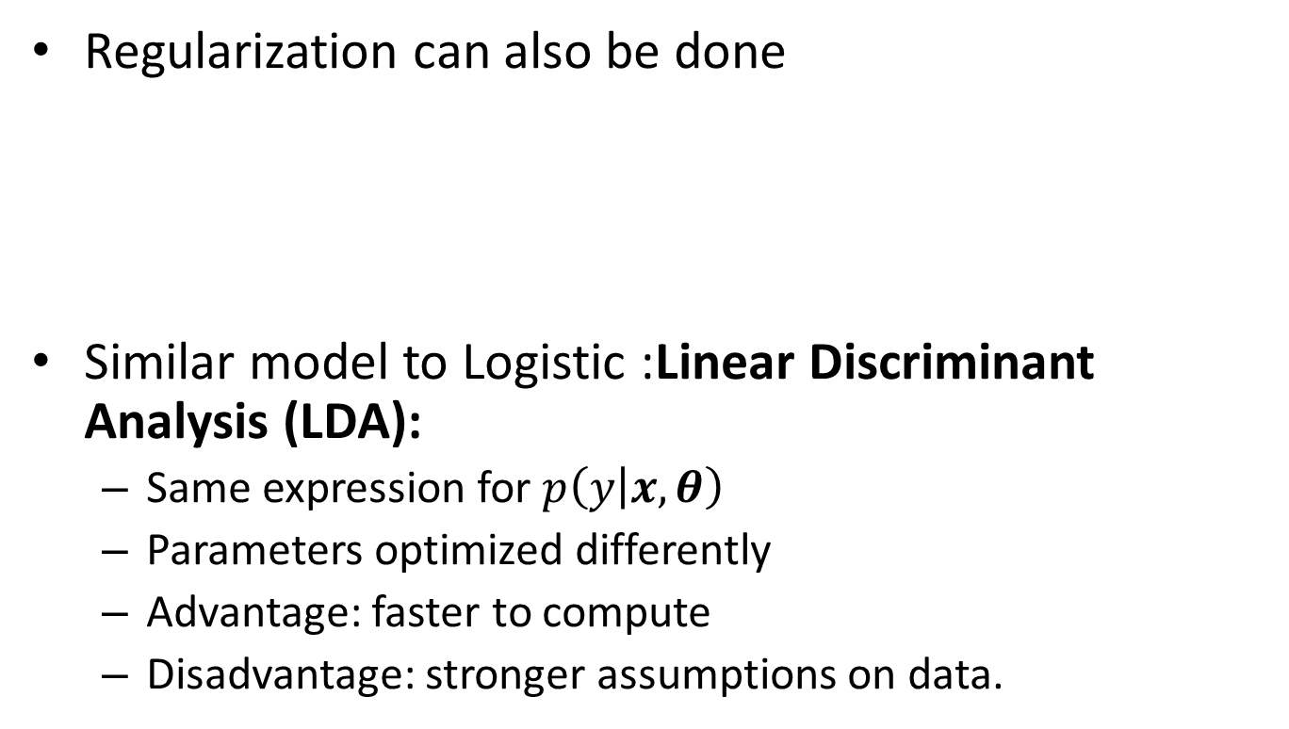
Logistic regression
Regularization can also be done
Similar model to Logistic :Linear Discriminant Analysis (LDA):
Same expression for $p\left(y | x,θ\right)$
Parameters optimized differently
Advantage: faster to compute
Disadvantage: stronger assumptions on data.

Slide 33
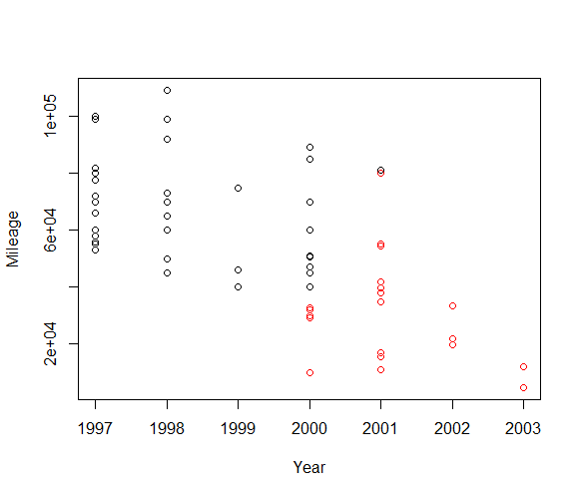
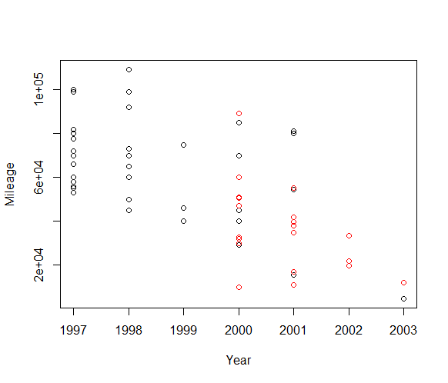
Logistic regression
In R, use glm() with family=”binomial” for two classes
Predict(glmobj, type). Choose type ”response” for probabilities
In R, use multinom () from nnet package for more than two classes
Example Equipment=f(Year, mileage)
Original data
Classified data

Slide 34
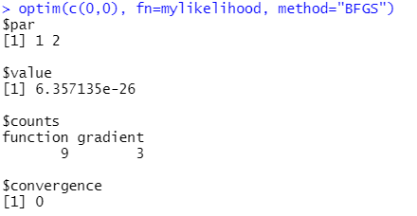

Optimization
How to optimize a given log-likelihood?
In R, use optim(start_point, function, method)
Example: minimizing ${\left(x_{1}−1\right)}^{2}+{\left(x_{2}−2\right)}^{2}$
df=data.frame(x1=1,x2=2)
mylikelihood<-function(x){
x1=x[1]
x2=x[2]
return((x1-df$x1)^2+(x2-df$x2)^2)
}
optim(c(0,0), fn=mylikelihood, method="BFGS")

